Slide 1
Ambient Temperature Monitoring How to install
© Shoestring and University of Cambridge
All information correct at the time of publication in March 2023. Step by step guidance produced using a Raspberry Pi 4B with 2GB of RAM and a 16GB SD card. Raspbian OS version 11 (bullseye) 32 bits and Python version 3 were used. Information is provided for free, on an as-is basis. User accepts responsibility for any issues arising.
Reproduction of this booklet, Ambient Temperature Monitoring How to install, in part of or as a whole is prohibited without the express written permission of Digital Manufacturing on a Shoestring and University of Cambridge’s Institute for Manufacturing. All rights reserved.

Slide 2
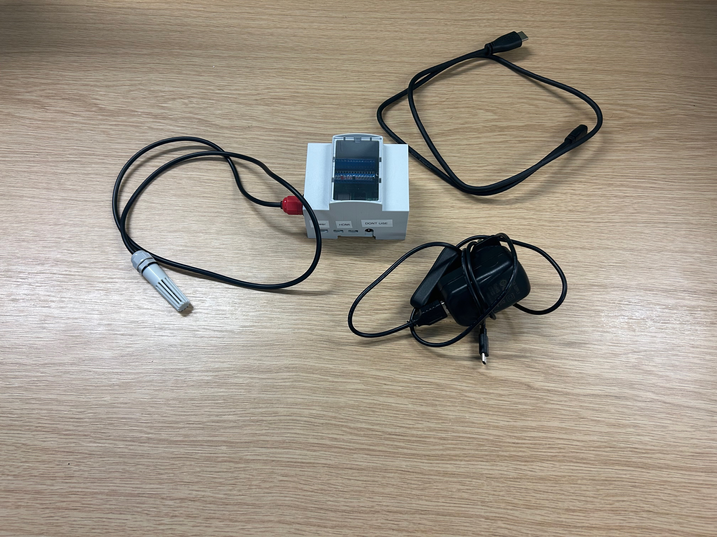
List of Equipment
Raspberry Pi 4b
Micro HDMI – HDMI cable
Air Sensor
Raspberry Pi 4b power supply
© Shoestring and University of Cambridge

Slide 3
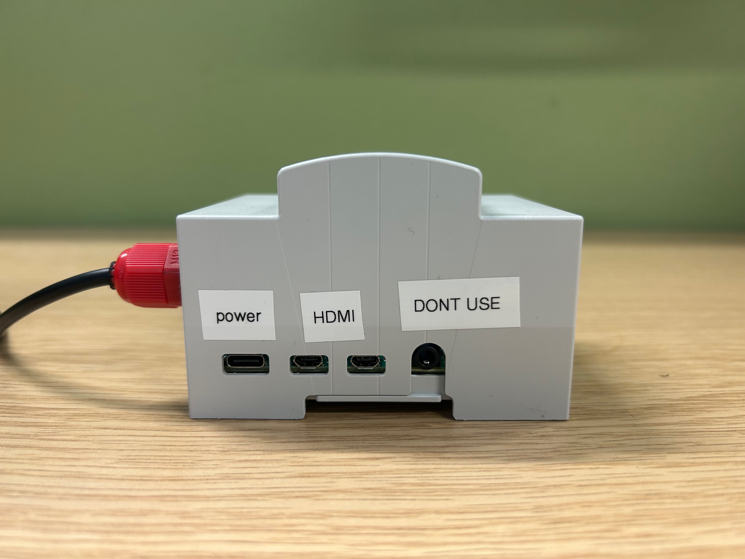
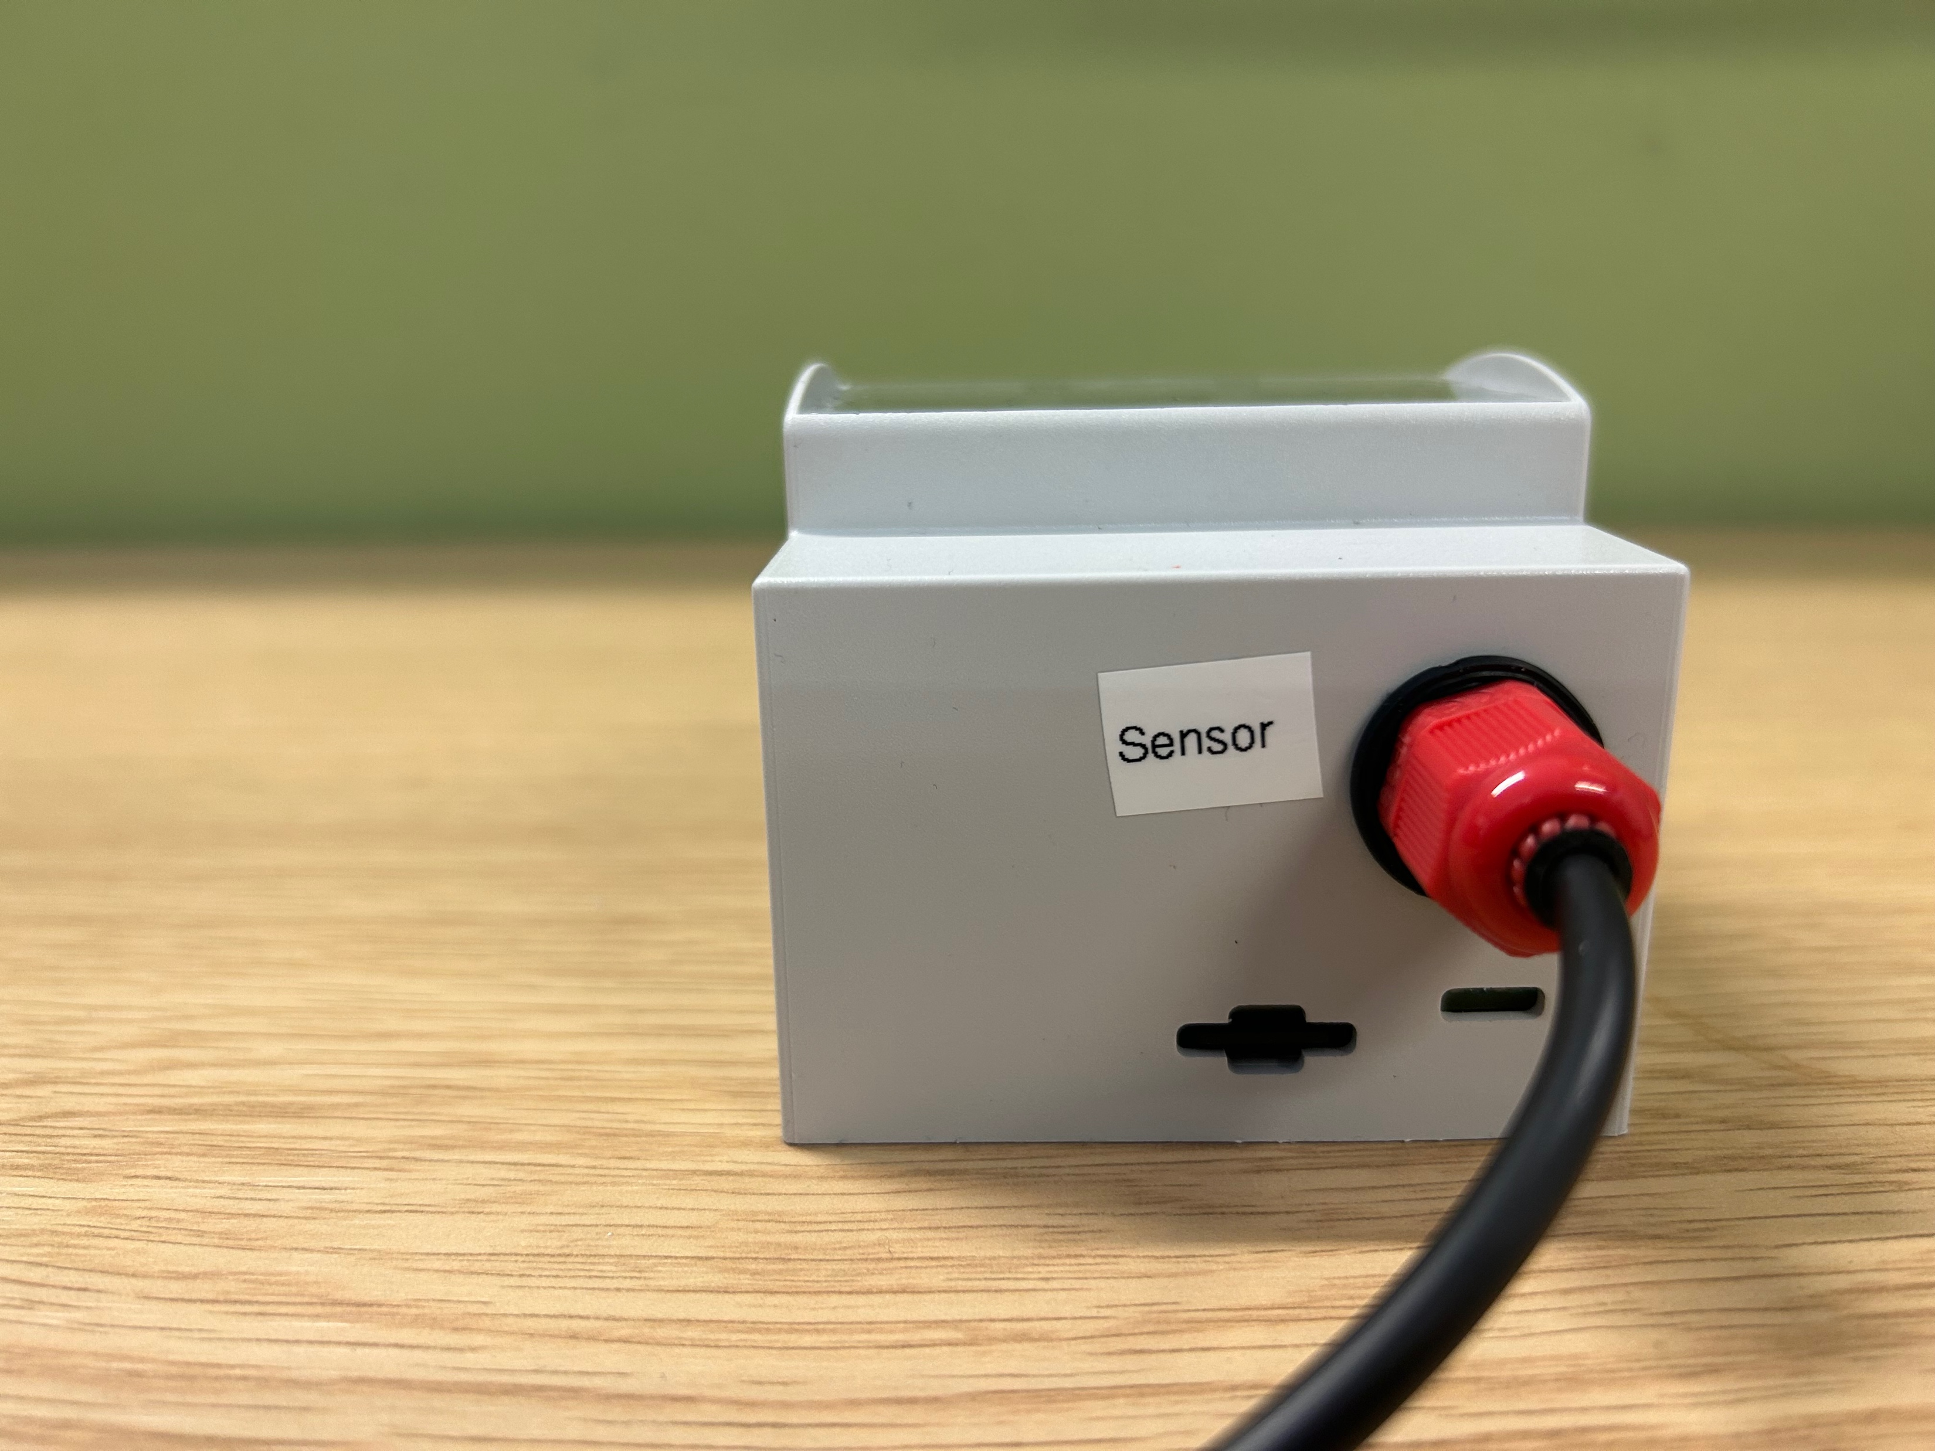
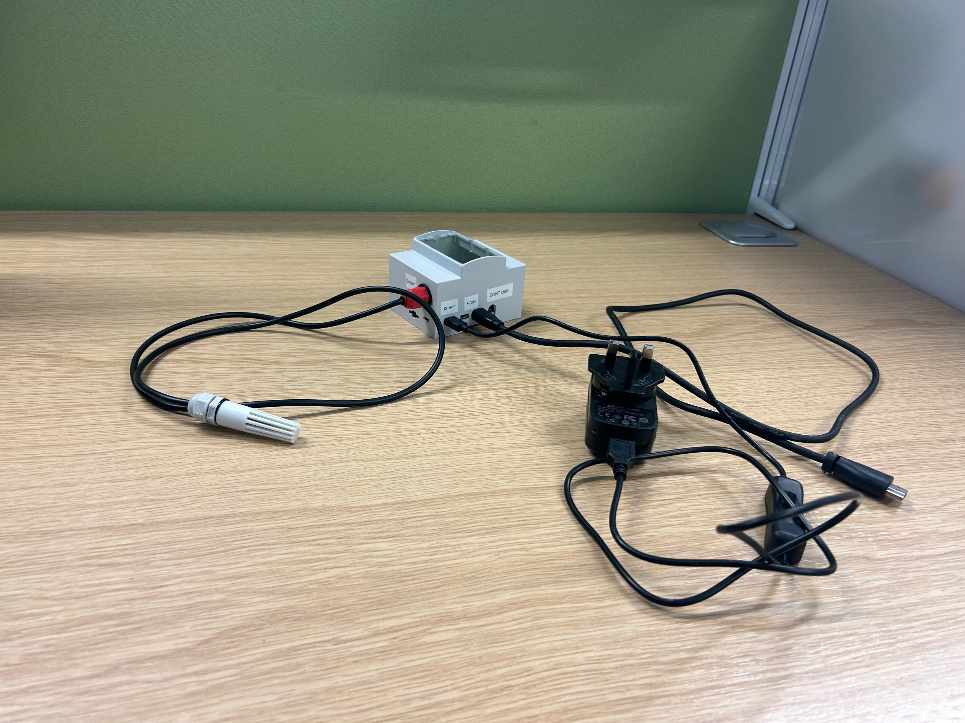
Equipment Set Up
Connecting equipment to the Raspberry Pi 4b
1. Plug in Micro HDMI – HDMI cable to monitor (optional)
Plug in Raspberry Pi 4b power supply
© Shoestring and University of Cambridge

Slide 4
Air Monitoring Solution Set Up Instructions
Mount the sensor at appropriate location
Power the Raspberry Pi 4b on
Connect the Raspberry Pi 4b to your local WiFi and take note of the IP address (alternatively connect a monitor to the Raspberry Pi 4b with the provided HDMI cable)
Open a browser and type IP:3000 in the address bar
Wait until Grafana is displayed – see page 5
© Shoestring and University of Cambridge

Slide 5
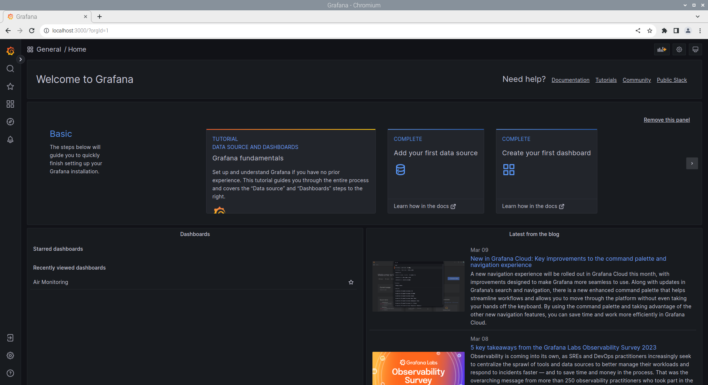
Dashboard (1/2)
Click on Air Monitoring
© Shoestring and University of Cambridge

Slide 6
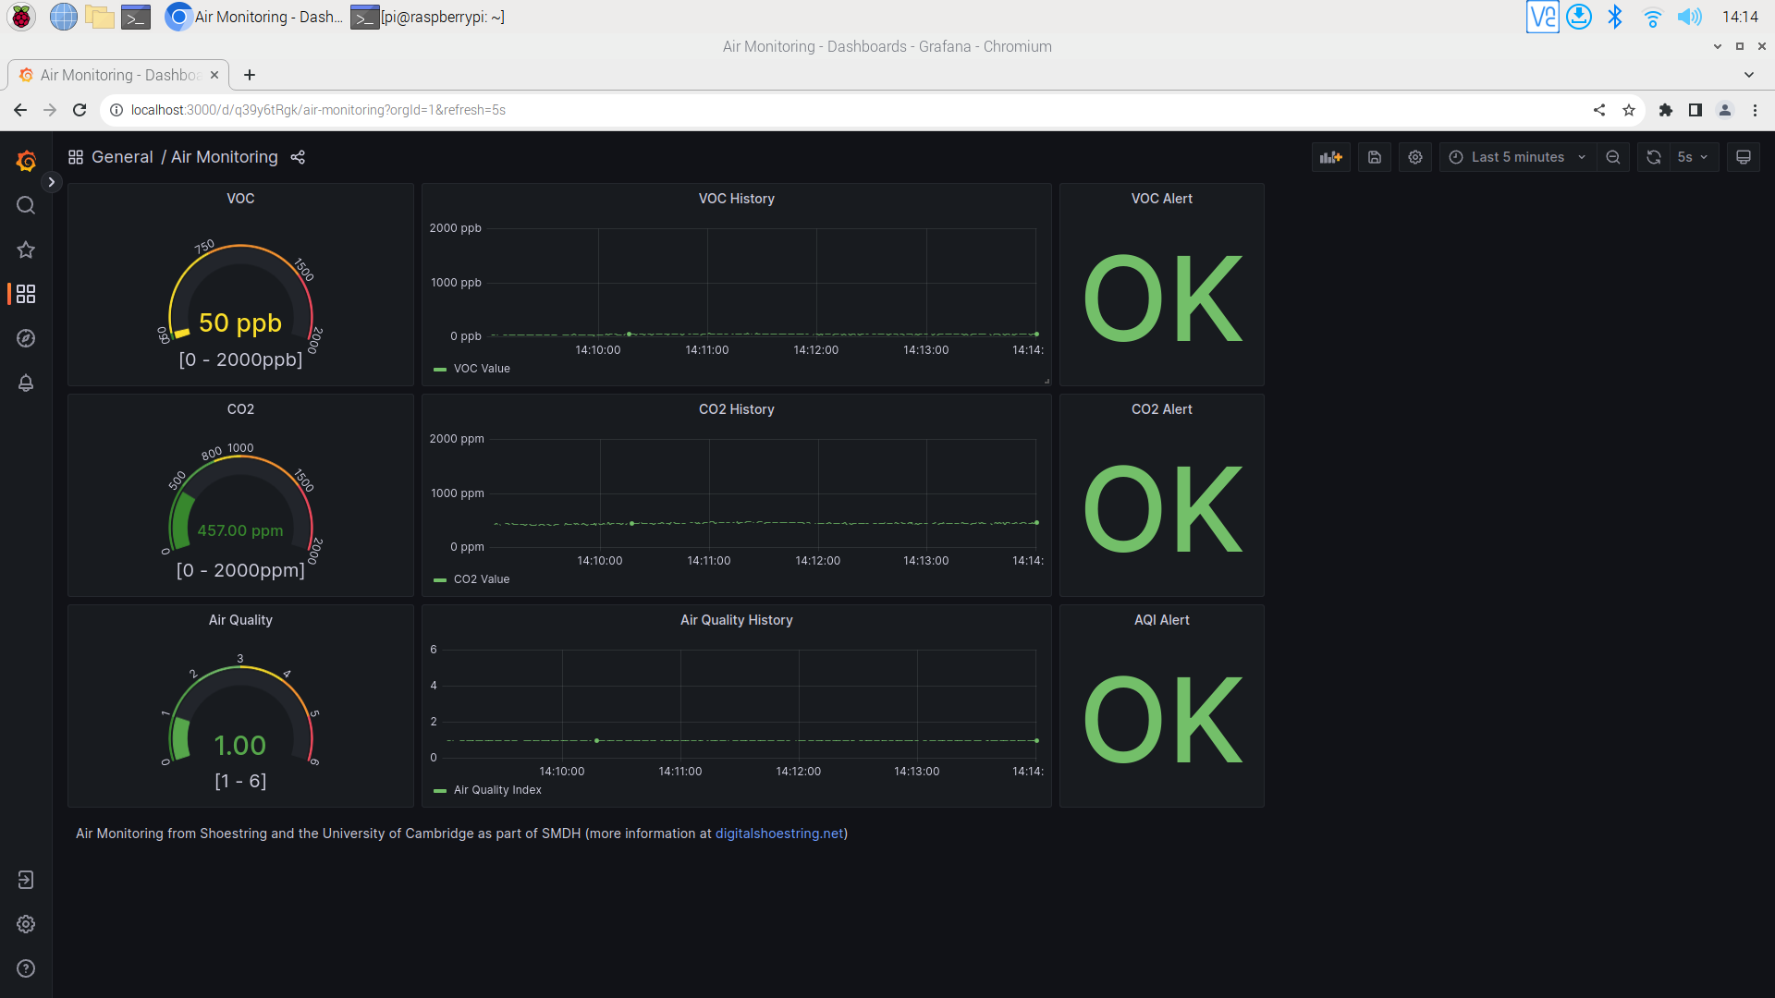
Dashboard (2/2)
Actual VOC
Suggestions
Actual CO2
Actual Air Quality Index
Historic VOC, CO2 and Air Quality Index
© Shoestring and University of Cambridge

Slide 7
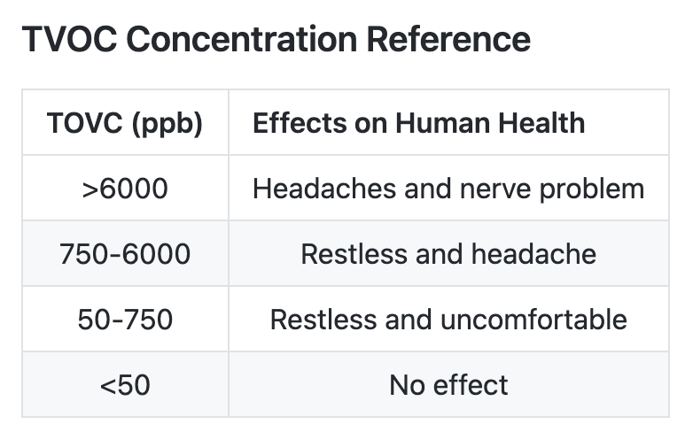
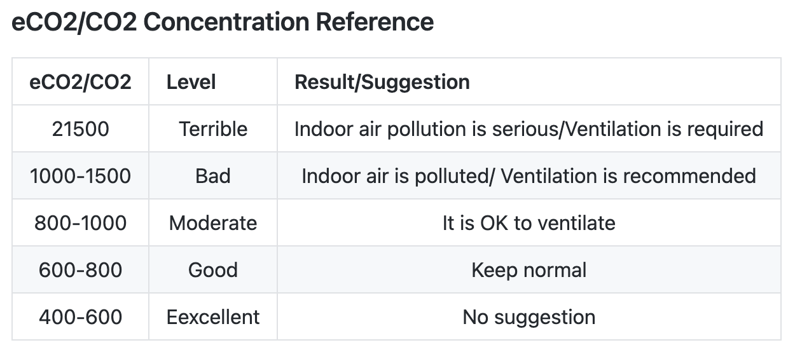
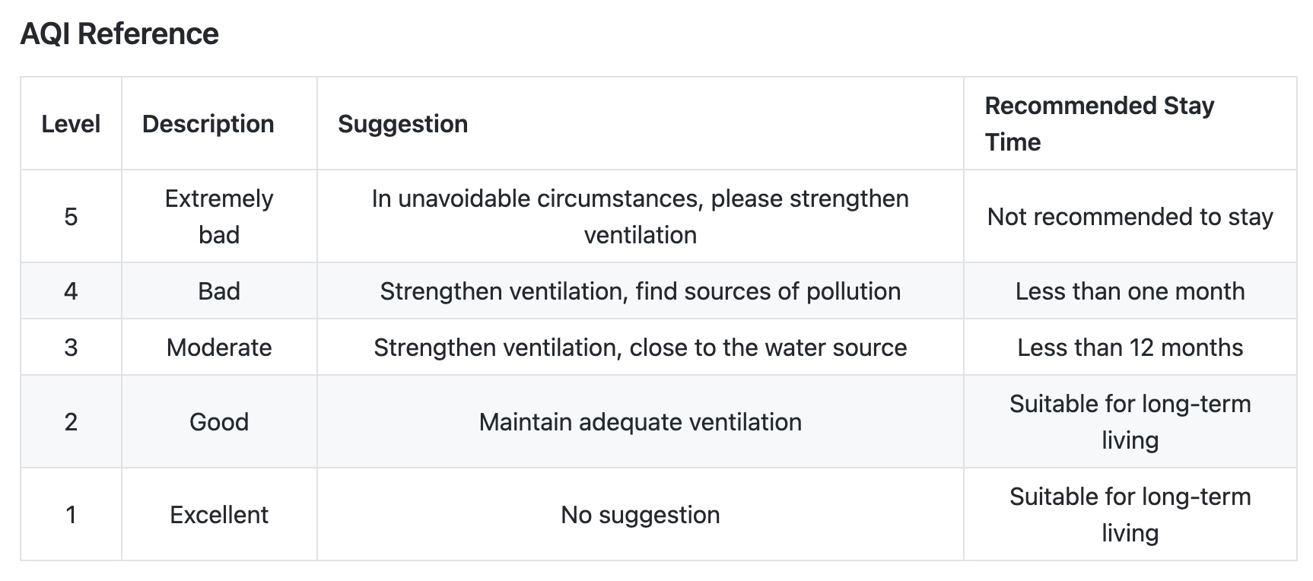
Reference
Reference: https://wiki.dfrobot.com/SKU_SEN0537_ENS160_Air_Quality_Sensor_I2C

Slide 8
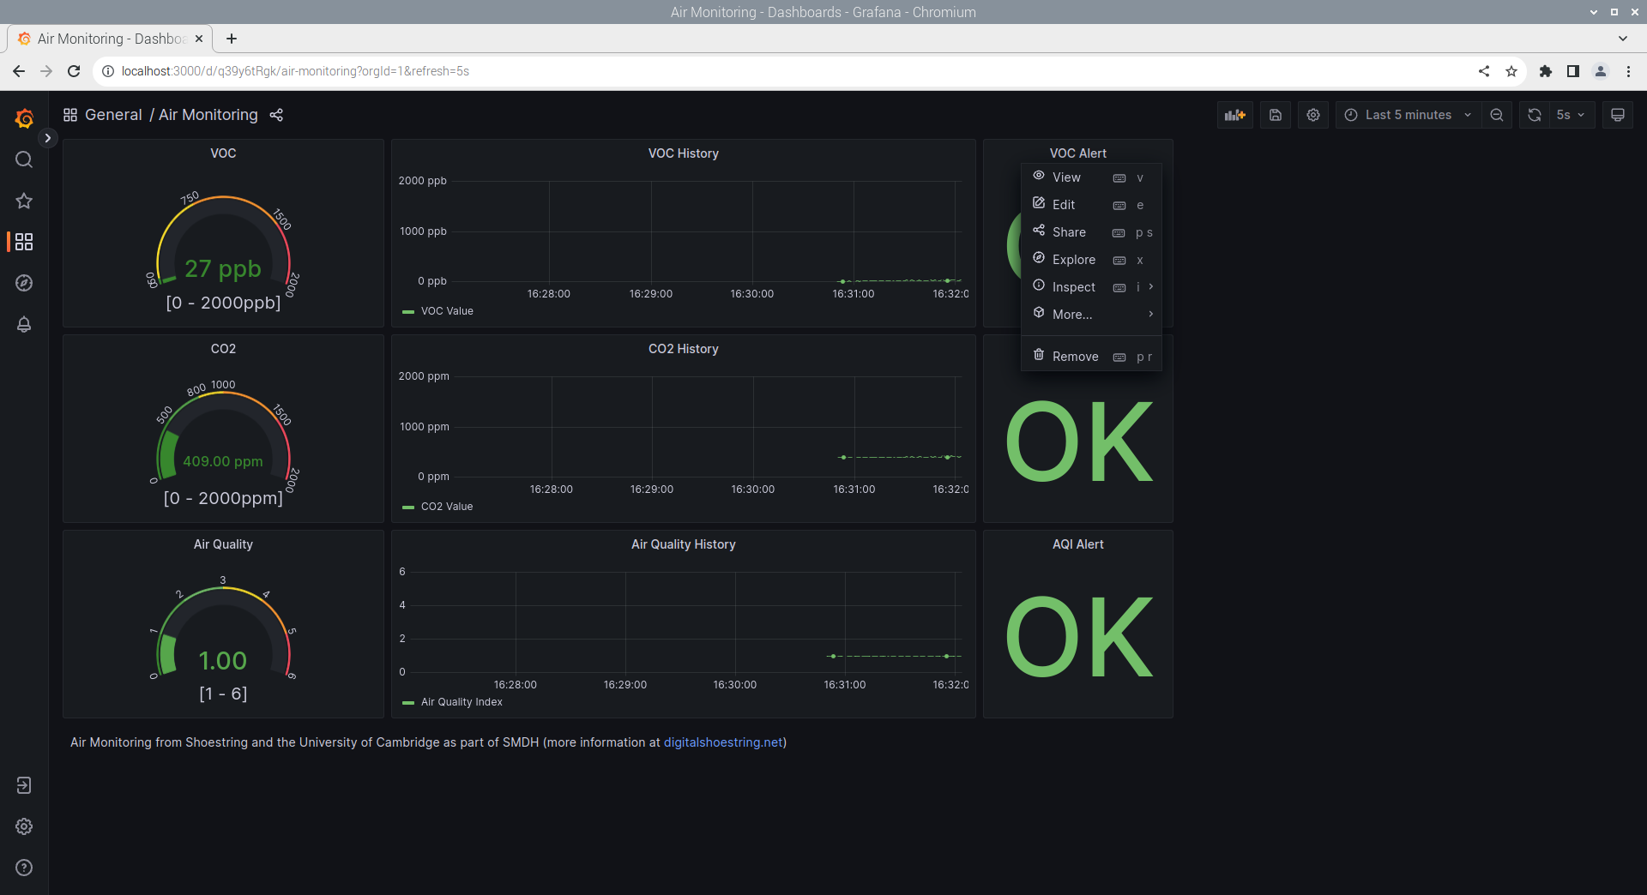

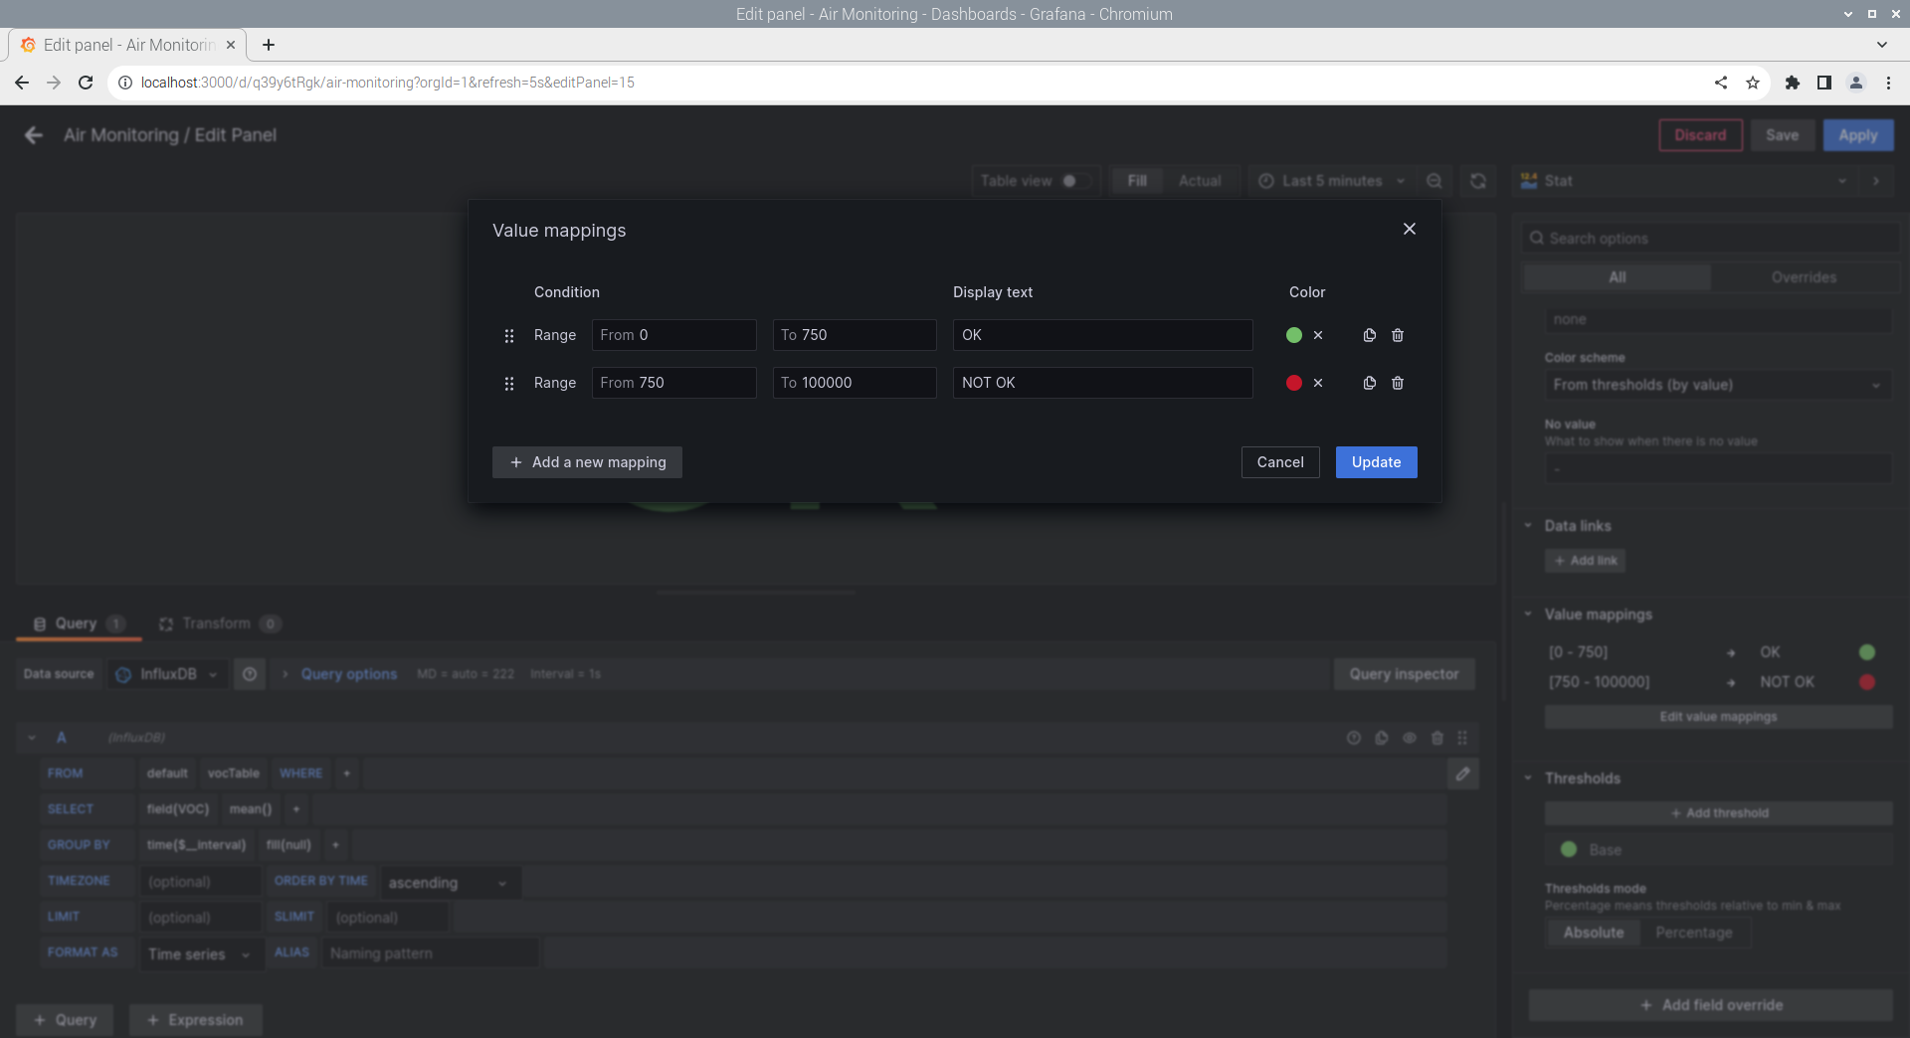
How to Modify the Threshold
2. Select edit value mapping
1. Click the panel name and edit.
3. Modify the threshold

Slide 9
Contacts
Please email contact@digitalshoestring.net for any questions
© Shoestring and University of Cambridge

